Slide 1

HB model:
Part-Worth Estimation

Slide 2





Slide 3









30M+ tracks
default on Android
up to 320kbps
“I’m feeling lucky” radio
$9.99, 4 month free trial
30M+ songs
desktop app
320kbps
Playlist radio
$9.99, 3 months for 99¢
1M+ tracks
Thumbprint Radio
192kbps
Music Genome Project
$9.99, $4.99 plus
30M+ songs
Siri virtual assistant
256kbps in AAC
average recommendations
$9.99, 3 months trial

Slide 4
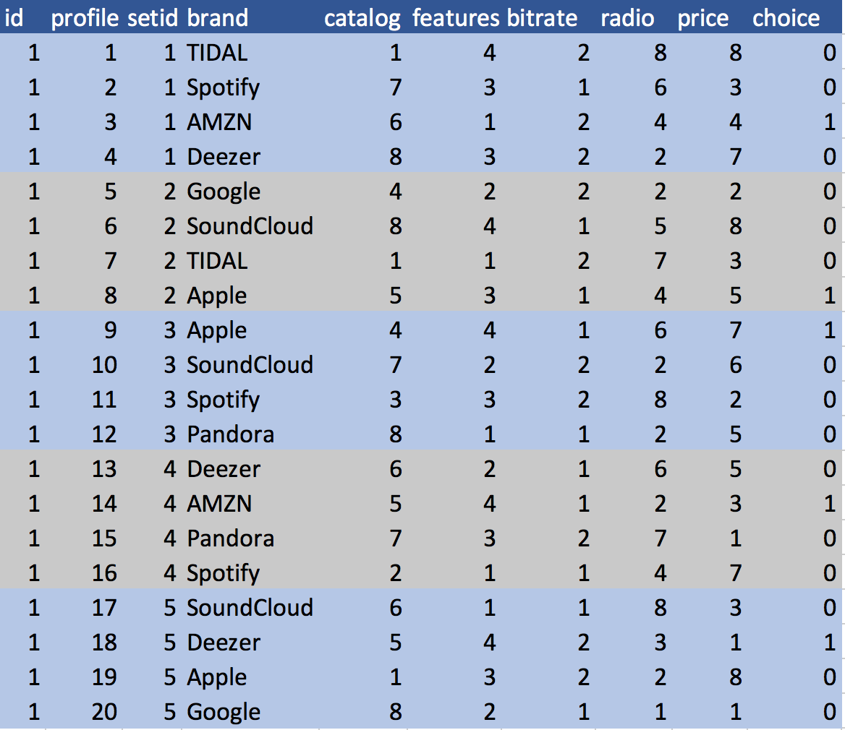
ABT

Slide 5
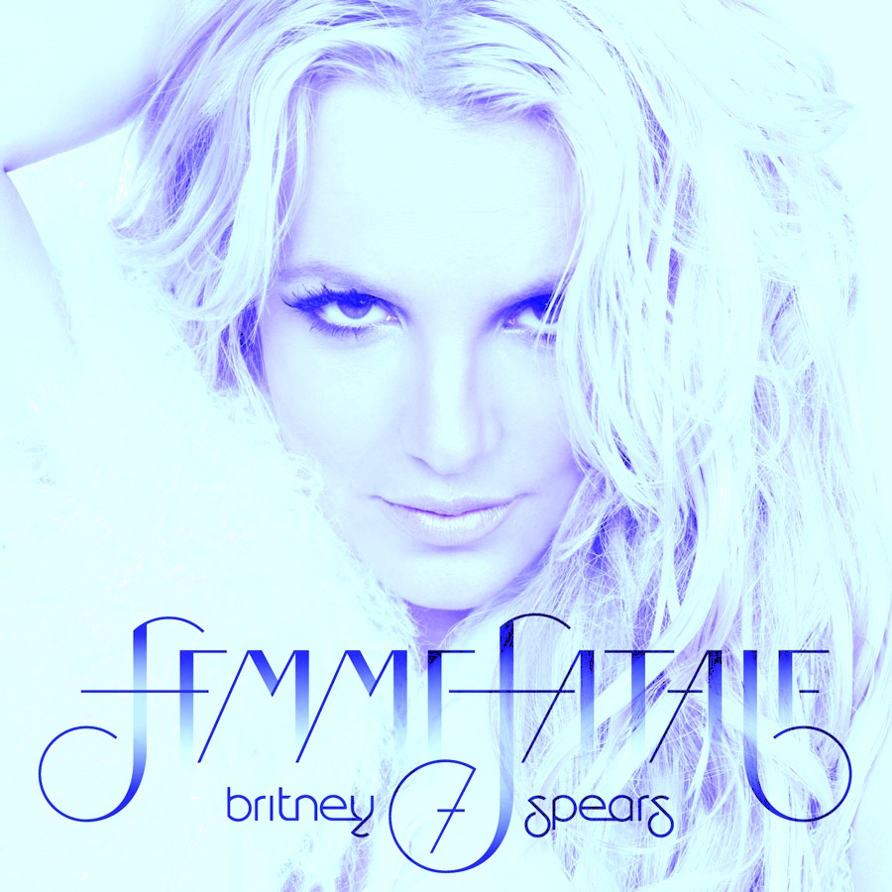
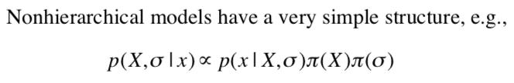
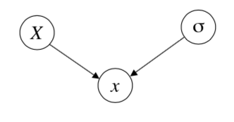

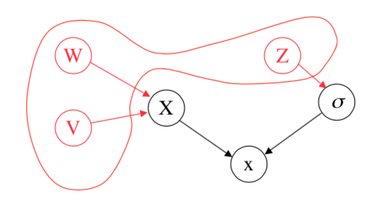
Hierarchical Models
use priors that themselves depend on other parameters not mentioned in the likelihood

Slide 6
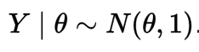
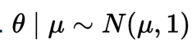
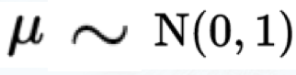
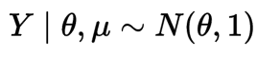
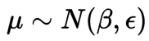
BH Modeling
deriving the posterior distribution
Prior distribution
Hyperparameter: parameter of the prior distribution
Hyperprior: distribution of a Hyperparameter

Slide 7
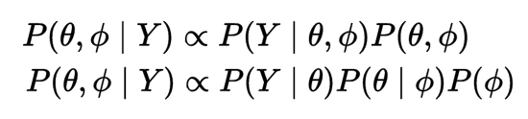
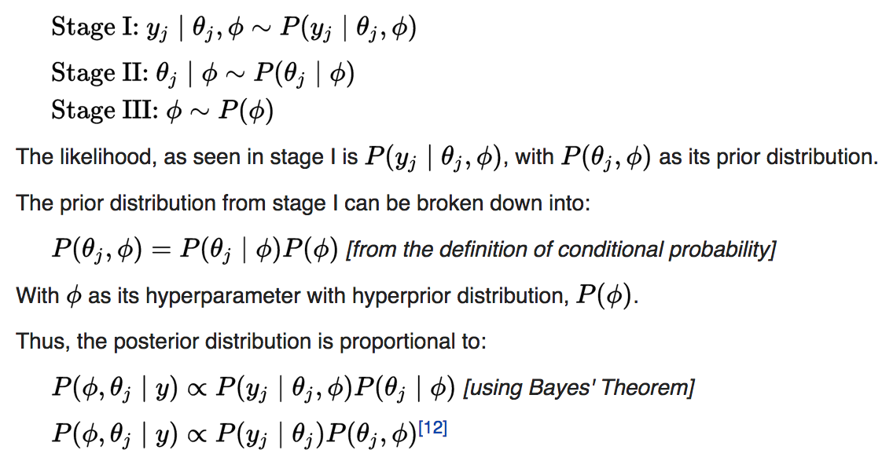
BH Modeling
use of hyperpriors gives more information to make more accurate beliefs in the behavior of a parameter
Notes:
https://en.wikipedia.org/wiki/Metropolis%E2%80%93Hastings_algorithm

Slide 8

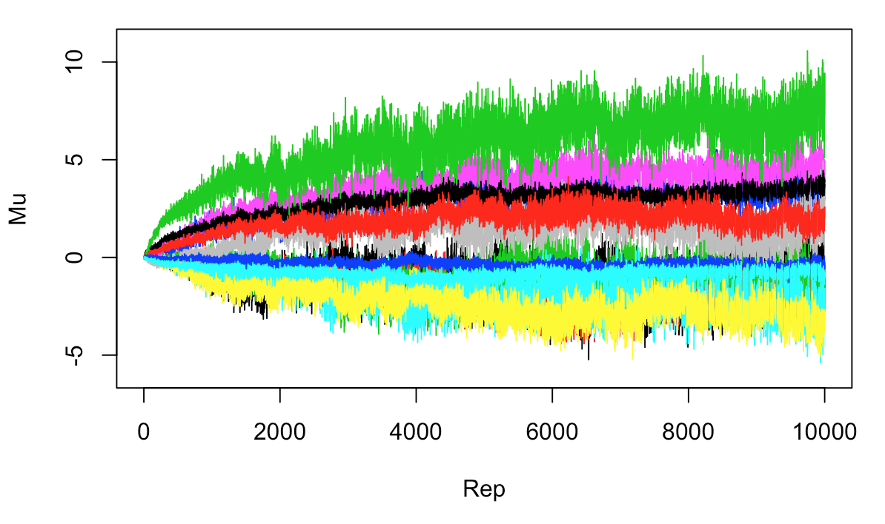
Gibbs MH-MCMC
MCMC algorithm to estimate a hierarchical multinomial logit model with a normal heterogeneity distribution. The algorithm uses a hybrid Gibbs Sampler with a random walk metropolis step for the MNL coefficients for each unit.
Notes:
https://cran.r-project.org/web/packages/ChoiceModelR/index.html

Slide 9
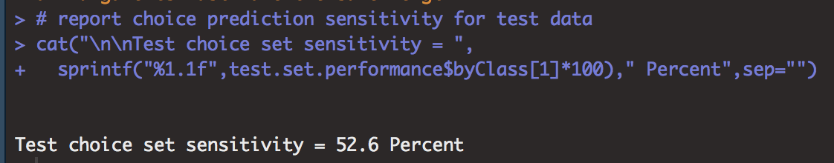
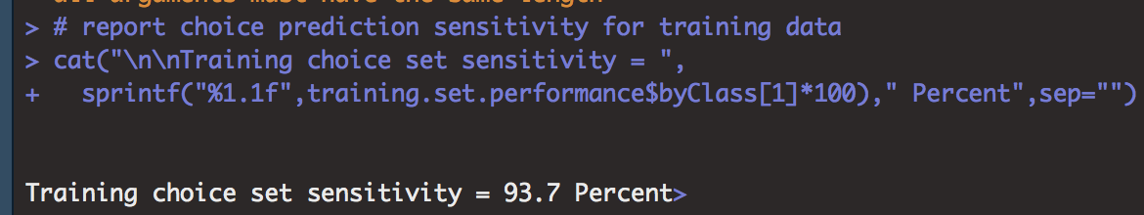
Training and Testing
MCMC algorithm to estimate a hierarchical multinomial logit model with a normal heterogeneity distribution. The algorithm uses a hybrid Gibbs Sampler with a random walk metropolis step for the MNL coefficients for each unit.
Notes:
https://cran.r-project.org/web/packages/ChoiceModelR/index.html

Slide 10
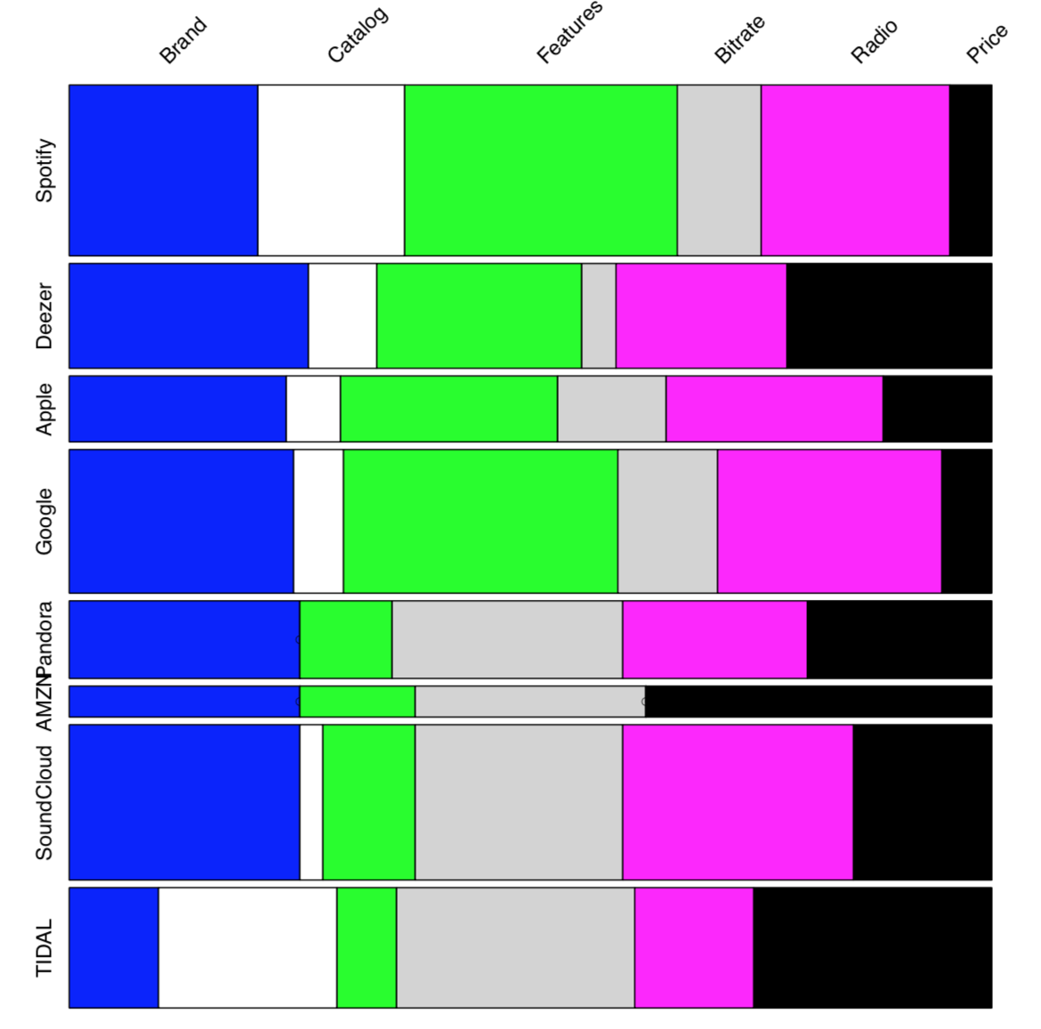
Mosaic of Top-Ranked Brands and Most Valued Attributes
Notes:
https://cran.r-project.org/web/packages/ChoiceModelR/index.html

Slide 11
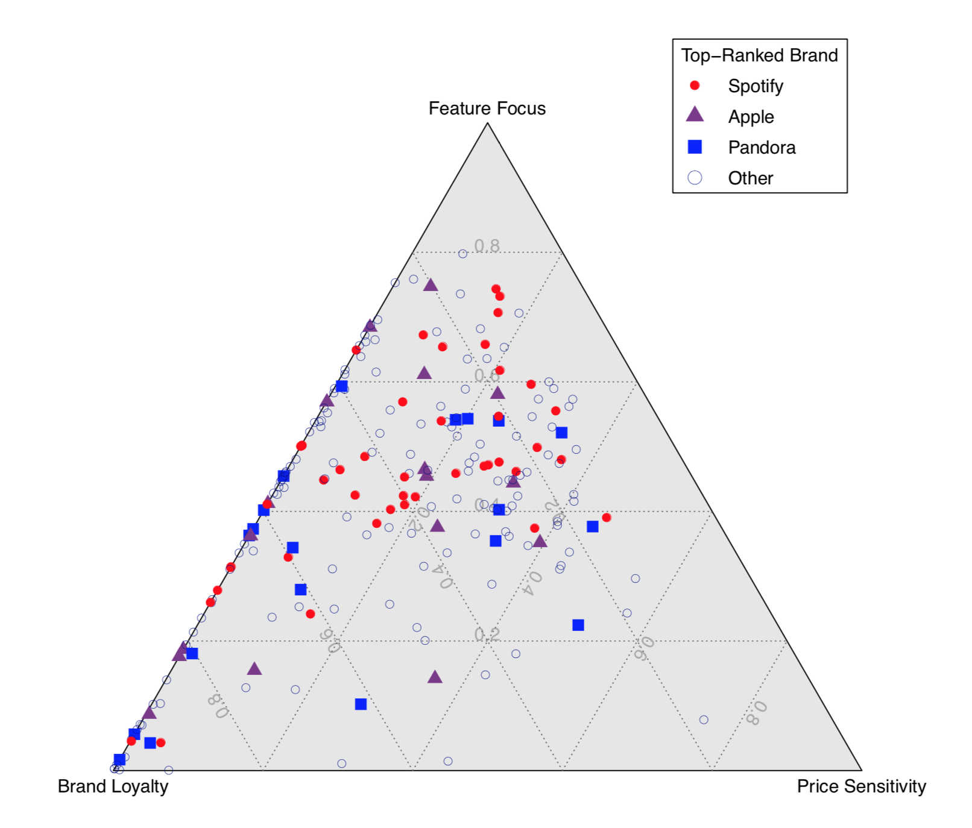
Ternary Plot of User Preference and Choice
Notes:
https://cran.r-project.org/web/packages/ChoiceModelR/index.html

Slide 12
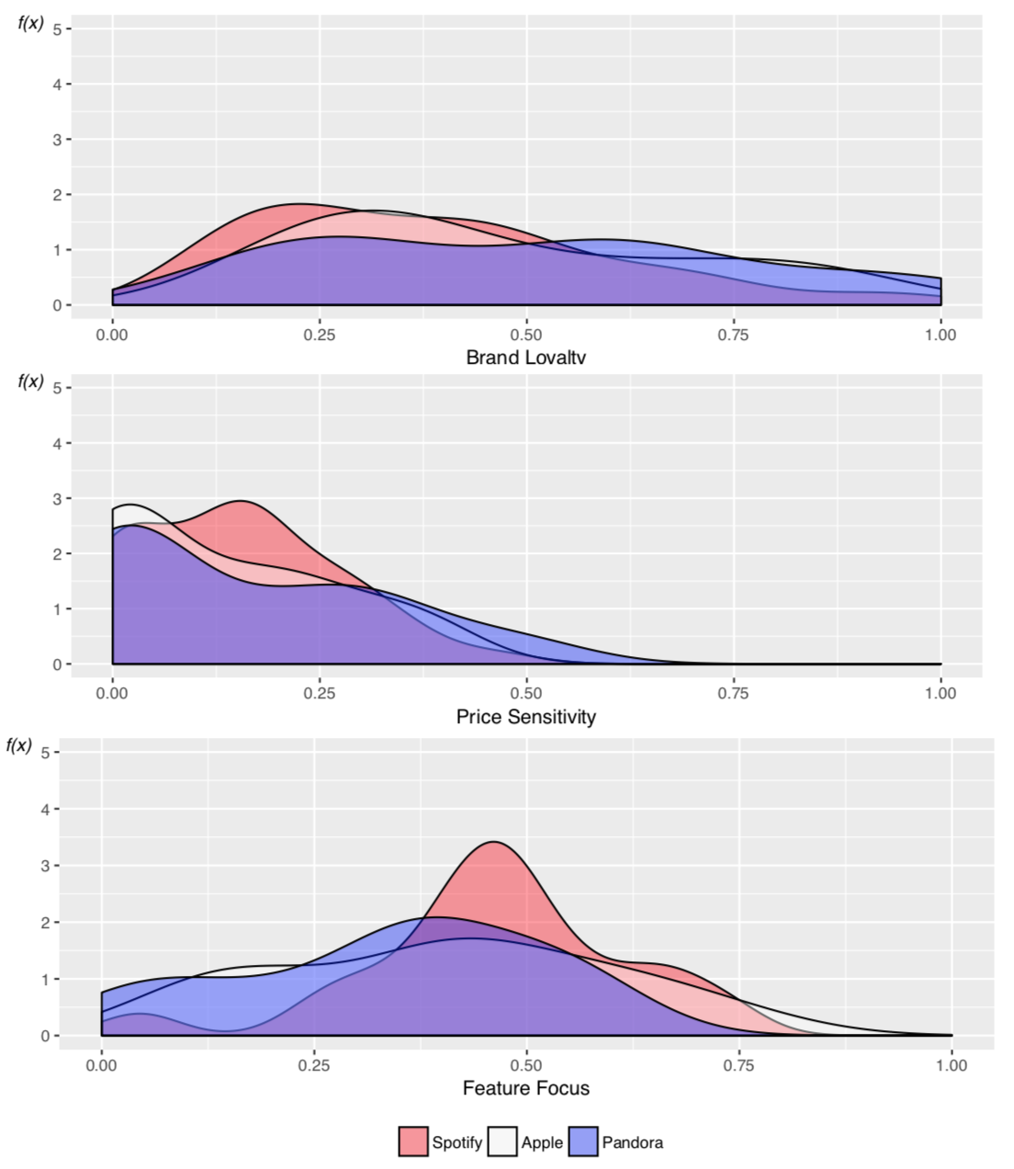
Comparing Listeners with Differing Brand Preferences
Notes:
https://cran.r-project.org/web/packages/ChoiceModelR/index.html

Slide 13
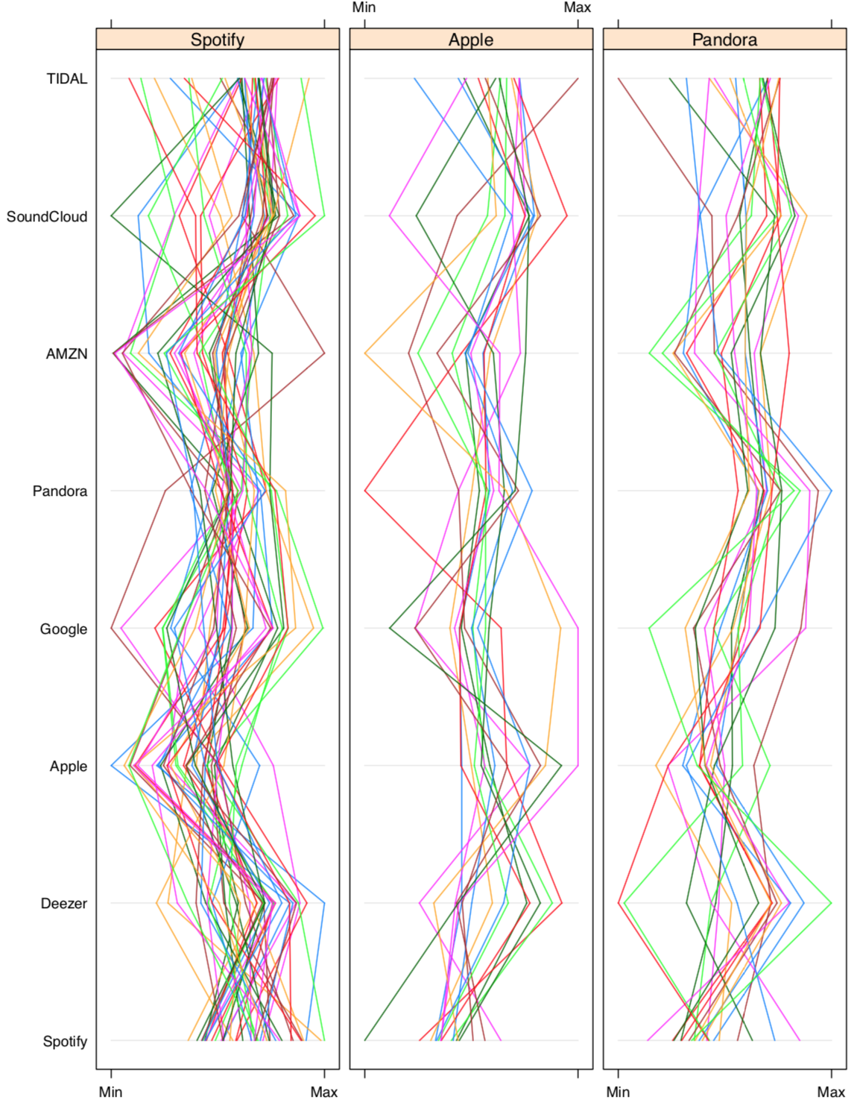
Potential for Brand Switching: Parallel Coordinates for Individual Users
Notes:
https://cran.r-project.org/web/packages/ChoiceModelR/index.html

Slide 14
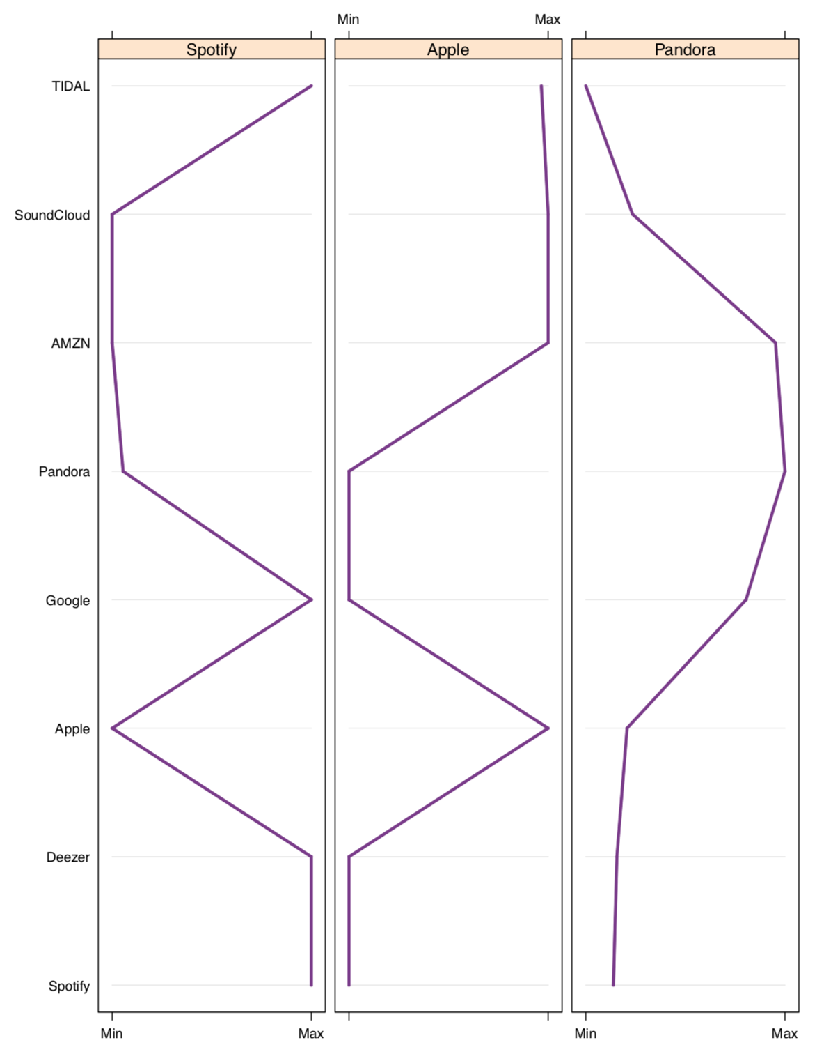
Potential for Brand Switching: Parallel Coordinates for Listener Groups
Notes:
https://cran.r-project.org/web/packages/ChoiceModelR/index.html

Slide 15
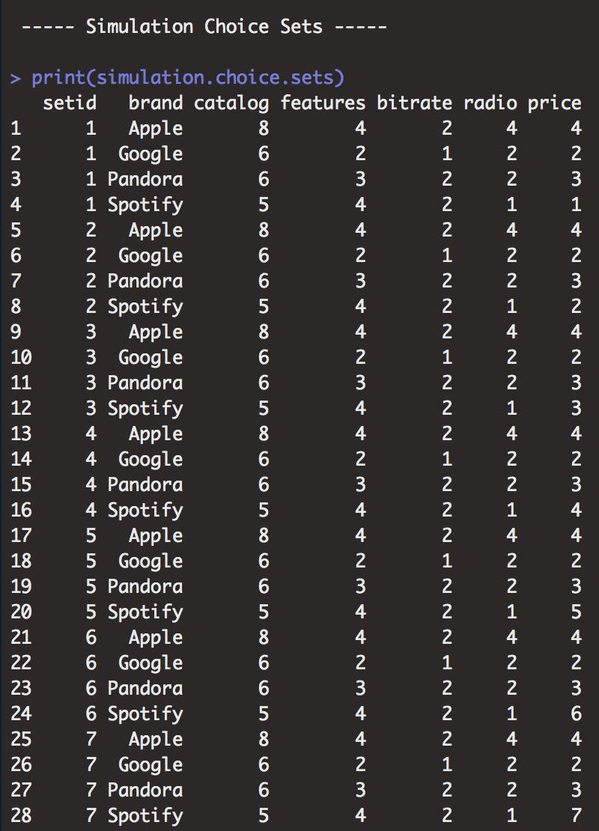

Choice Set Input for Market Simulation
Notes:
https://cran.r-project.org/web/packages/ChoiceModelR/index.html

Slide 16
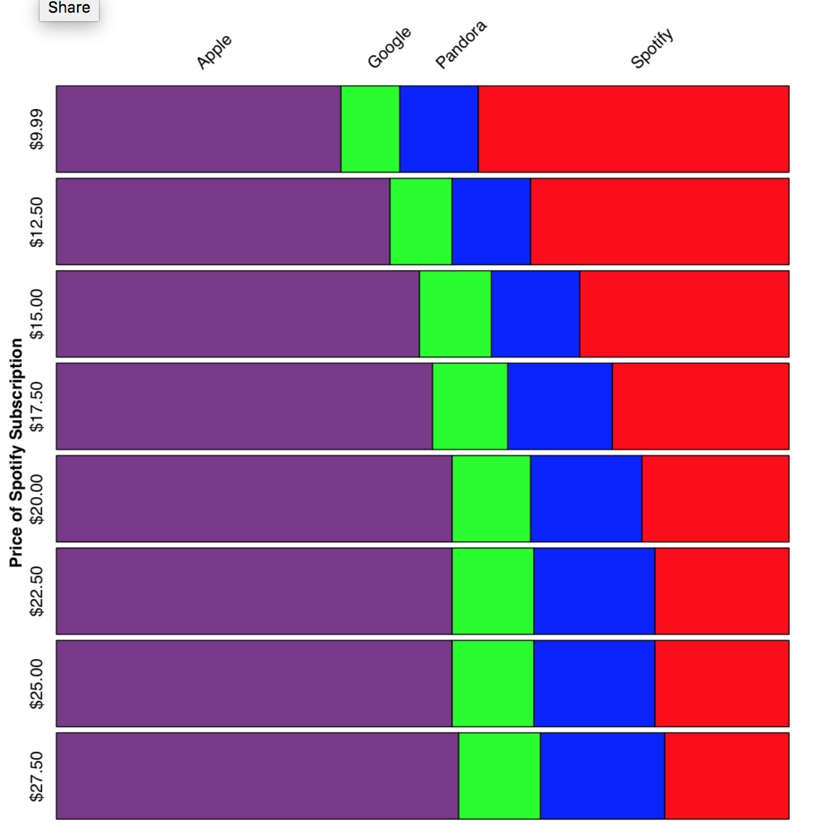
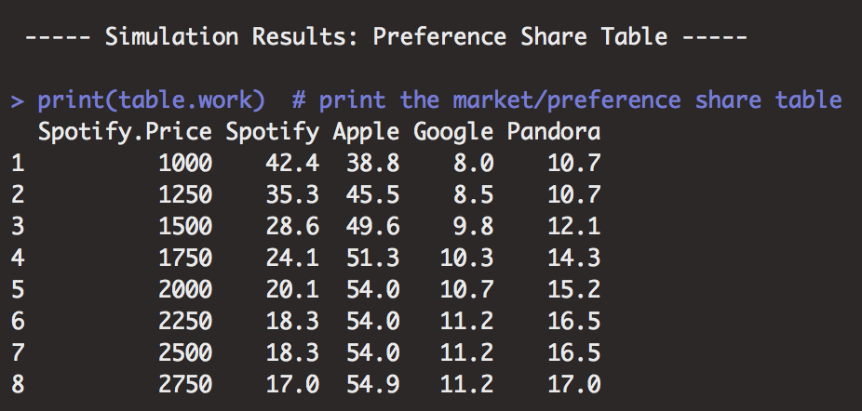
Market Simulation: A Mosaic of Preference Shares
Notes:
https://cran.r-project.org/web/packages/ChoiceModelR/index.html

Slide 17
References:
idiom.ucsd.edu/~rlevy/pmsl_textbook/chapters/pmsl_8.pdf
koganpage.com/product/marketing-analytics-9780749474171
ftpress.com/miller
rdocumentation.org/packages/ChoiceModelR/versions/1.2/topics/choicemodelr
astrostatistics.psu.edu/samsi06/tutorials/tut1jefferysl2.pdf
en.wikipedia.org/wiki/Bayesian_hierarchical_modeling

